Slide 1
Hacking the Telemarketing Game
By: Enadi Pasholli, Ryan Mulcahey, and Jonathan Luo

Slide 2
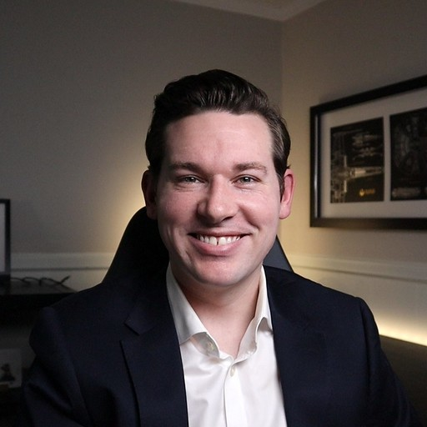

Who Are We?
Client
Ryan Mulcahey
Fairfield University MSBA Student
Experience in banking for 9+ years
VP, Data Strategy at BNY Mellon
Enadi Pasholli
Fairfield University MSBA Student
Data Analytics Intern at the Hartford
Jonathan Luo
Fairfield University MSBA Student
CEO, Luo Bank

Slide 3
Why Are We Doing This?
The bank is faced with economic conditions that require it to hold more assets
The product being promoted is a long-term deposit account
Marketing is looking for the most resource efficient strategy to achieve the most conversions per customer interaction

Slide 4
Marketing Strategy
Existing Strategies in Use Today
General Marketing to Mass Audience
Pros Wide reach of targets to open new accounts Cons Conversion rate can be very low and prove unsuccessful to business objectives
Direct Marketing to Existing Customers
Pros Much more efficient way to get new accounts opened Cons Might create negative sentiment to banks for invading personal information

Slide 5
Proposed Strategy
Use machine learning to assess likelihood of existing customers converting from marketing campaign
Potential benefits
Improve campaign efficiency
Only contact those that are most likely to convert upon contact
Conserve company resources
Diagnostics for why people are not converting
Potentials risks or gaps
Limited number of contacts to reach
Model will not include all customers that would convert from contact

Slide 6
Our data
We looked at previous marketing campaigns from 2008 to 2013 to tease out the main drivers of customer subscription to long term deposit accounts
27 Columns, 45,307 rows
From the data we have customer information such as age, job, marital status, education, housing status, loan status, and self reported total assets.
We have data from the campaign metrics like type of communication, the month and the day of week the contact was made, the number of contacts with the customer before the campaign, and the outcome from previous marketing campaigns
The data consists of socioeconomic information such as employment rate, CPI, consumer confidence index, 3-month Euribor rate, and the number of employees at the time of each contact
Finally, we have miscellaneous information that consists of customer ratings, language the customer speaks, average rating of the representative, how long the customer has had a relationship with the bank, and if they have relationships with other banks

Slide 7
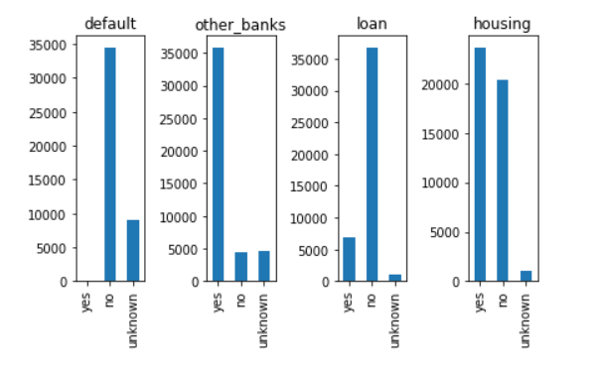
Categorical Data About Customer Finances

Slide 8
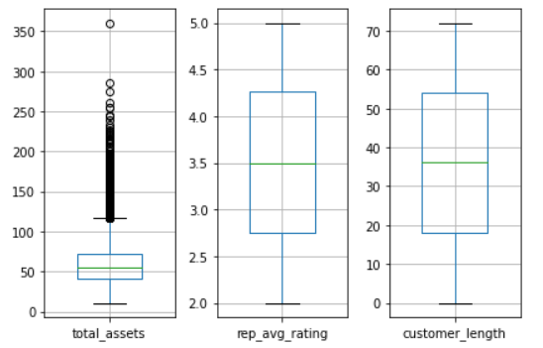
Customer Relationships with the Bank

Slide 9
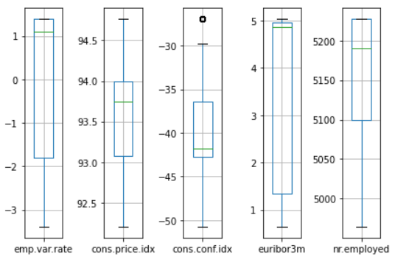
Macro Economic Indicators

Slide 10
Data Assumptions
Information that was not used
Loan Defaults
Not enough information to make claims from data
The length of time that the campaign phone call lasted
This could not be used because the information about the call contains whether someone would be opening an account.
Information that was grouped together
Number of days from last campaign: this was grouped into a yes or a no, either you were reached out to or not
Education : Grouped by similarities - illiterate, pre-high school, high school and post high-school
Age : Similar stages - <25, 26-35, 36-45, 46-55, 56+
Job : blue-collar, white-collar, services, other, and unknown
Months are grouped into quarters
Unknowns
Unknowns were dealt with by keeping them as a separate category for each data feature
Created Features
Positive or negative customer experience

Slide 11
Data Hurdles
Imbalance in target variable
Missing Values
‘unknowns’ in many categorical columns
Condensing data features with many

Slide 12
Model Performance
Primary conversion drivers
Number of Contacts Performed During this Campaign and for this Client
CPI
Total Assets
Rate of the Euribor
Length of the relationship with the bank
Customer Rating of the Current Campaign
Average rating of the representative prior to the current campaign
Customer profile
Age 25 – 50
Contacted in late spring or early summer
Total Assets between 40-150K Euro
Contacted by a highly rated representative
Rated interactions as positive experiences
Model Benchmarks
Used 6 different machine learning algorithms
Our best model accurately predicted 83% of the cases it examined

Slide 13
Implementation Recommendations
Based on our model's performance we recommend to use its findings to streamline telemarking strategies
The model has built a basic customer profile to target first
Ability to run individual customer profiles through the model and get an understanding of their likelihood of converting
Training for lower rated customer representative on best practice reaching out to customers
Empower representatives on how to best handle the interaction to answer questions / solve problems
Target customers with assets between 70k and 200k for maximum conversion rate
Find a way to contact customers who had not been part of a previous campaign through an easily scalable method and follow up - this indicator is a driver for conversion rates in future campaigns

Slide 14
Why We Should Change Strategies
While this analysis is based on prior campaigns, we think these results can be used as a baseline for future campaigns.
Given the responsiveness of customers to highly rated representatives, it would be best to focus the outreach effort on target customers by these representatives to maximize the customer experience.
By reaching out to identified target customers, we can make our telemarking efforts more efficient.

Slide 15
Next Steps
Look into how macroeconomic factors impact the outcome of campaigns
Gather more data
Increase collection of information on customers and other factors
Build better models
Apply findings to marketing campaigns other than telemarketing

